Slide 1
Broker Statewide Webinar
February 12, 2026, 12:00 p.m.
The webinar is not being recorded, but this PowerPoint will be available on Assister Central
During the webinar, please use the “chat”
feature to submit questions.

Slide 2
Open Enrollment Wrap-Up
THANK YOU for your hard work during a challenging and busy open enrollment period!
Over 162,000 Minnesotans sign up for private health plans.
  Fewer new QHP consumers than last year.
  More plan changes and terminations than last year.
  But overall, only a 3% decline from last year’s record setting open enrollment.
50% of enrollees are eligible for advanced premium tax credits, with families saving an average of close to $7,320 per year.
In January alone, Minnesotans received nearly $25.5 million in advanced premium tax credits to help lower health insurance costs.
More details available in the Document Library on MNsure.org under “About Us/Board of Directors and Advisory Committees.”

Slide 3
Tax Time Reminders
MNsure mailed 1095-A forms in January to consumers who enrolled in a qualified health plan through MNsure for any part of 2025.
  In addition to the “Notifications” tab in their METS account, the 1095-A is available in the “My Inbox” section of a consumer’s enrollment dashboard.
  Reminder: Assisters should not view or print a consumer’s 1095-A form and are prohibited from providing tax advice.
Special enrollment period opportunity!
  Individuals who are uninsured can check a box on the individual income tax form in Minnesota (Form M1).
  After they file their taxes, they will get a letter from MNsure about coverage options and next steps.
  They will have a 65-day SEP to apply and enroll in a qualified health plan, if they’re eligible.

Slide 4
Federal Changes Impacting Consumers
Effective Plan Year 2026: Repayment limits on advanced premium tax credits have been removed for 2026 tax filing. More important for consumers to report changes that could impact their eligibility.
Effective Plan Year 2027: Marketplaces must end their open enrollment period no later than December 31.
Effective Plan Year 2027: Many lawfully present immigrants will no longer have access to advanced premium tax credits.
Effective Plan Year 2028: All enrollees seeking premium tax credits will need to take extra steps to maintain their eligibility, effectively ending auto-renewals of coverage.

Slide 5
Future MNsure Changes
MNsure’s new eligibility system is scheduled to launch in late June 2026!
  Streamlined the application, eligibility and enrollment process for QHP consumers.
  Provides a more user-friendly, intuitive self-service experience for both consumers and assisters.
Transition steps coming soon:
  MNsure will be collecting additional information from assisters to support migrating you and your book of business into the new MNsure assister portal.
  Additional training requirements will begin April 1.

Slide 6

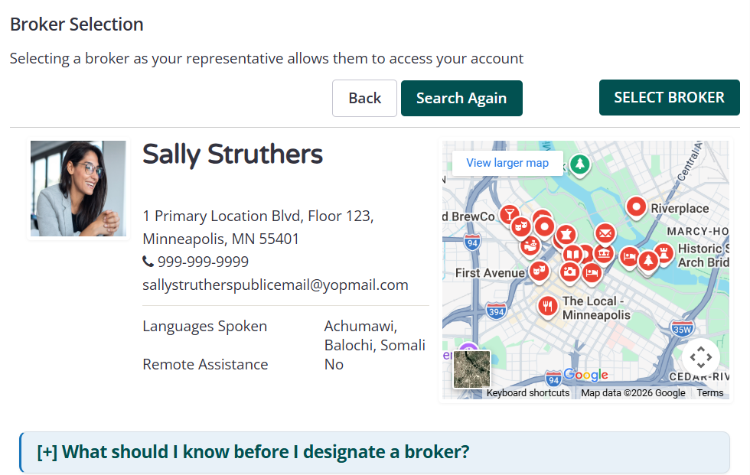
New Directory Experience

Slide 7
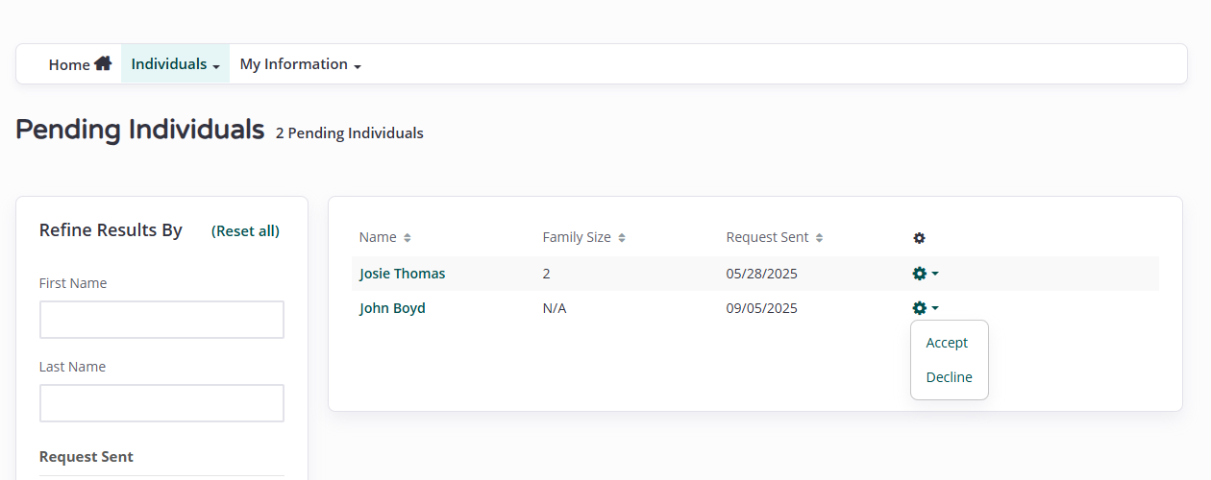
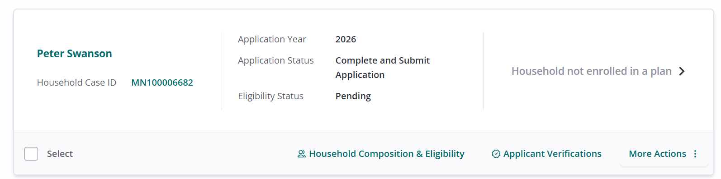
Enhanced Assister Portal

Slide 8
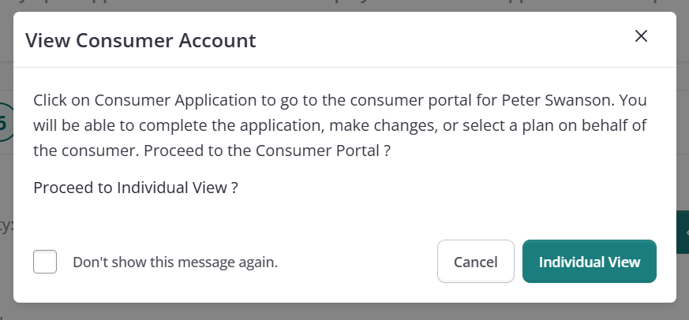
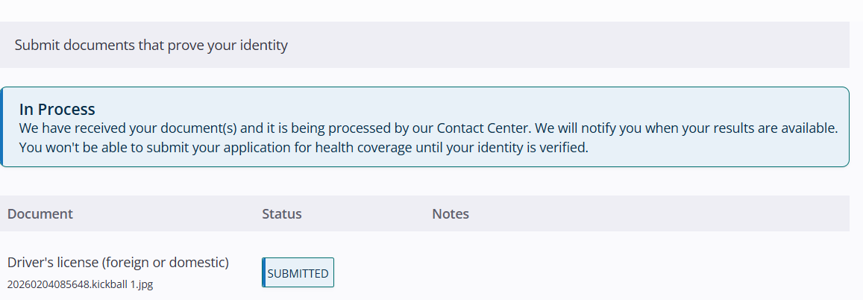
Full Access to Self-Service Options

Slide 9
Thank You for Attending!
Please submit any questions via chat.

