Slide 1

Open Enrollment Toolkit
Plan Year 2026
November 1, 2025 – January 15, 2026

Slide 2
Introduction
Right now, more Minnesotans have health insurance than ever before, and we want to keep that momentum going.
Here’s what we’re asking Minnesotans to do:
Review your current plan to make sure it still meets your needs
Make a plan to enroll starting November 1
Schedule a free appointment with a MNsure-certified expert to get help comparing options
Check in with family, friends and neighbors to make sure they’re covered, too
Thank you for partnering with MNsure to help spread the word and connect Minnesotans to quality health insurance coverage.

Slide 3
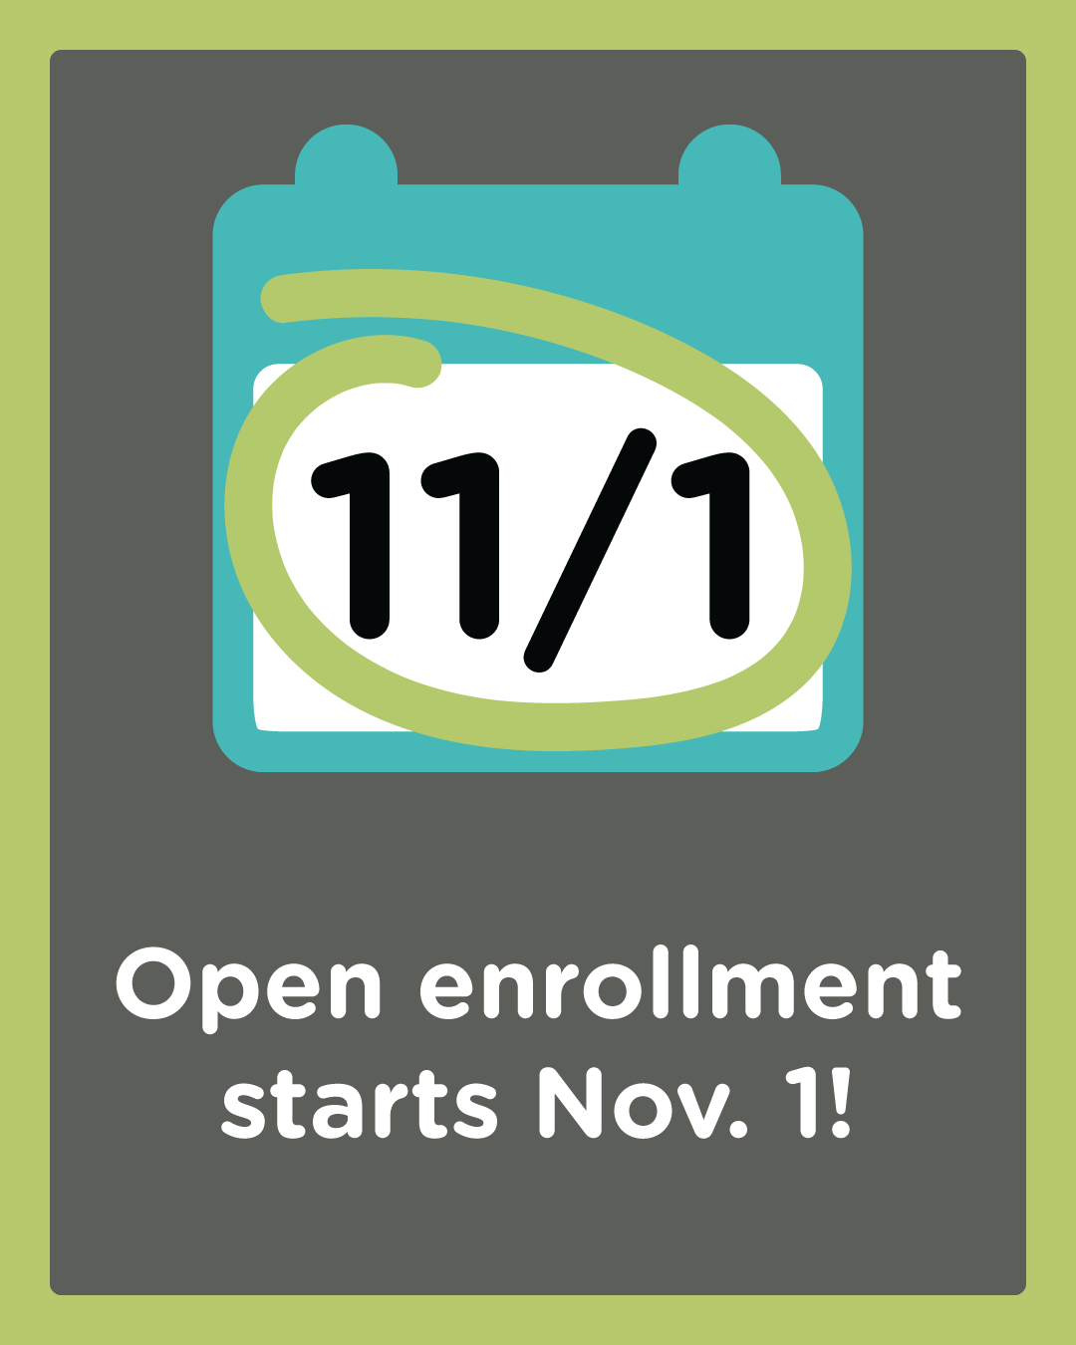
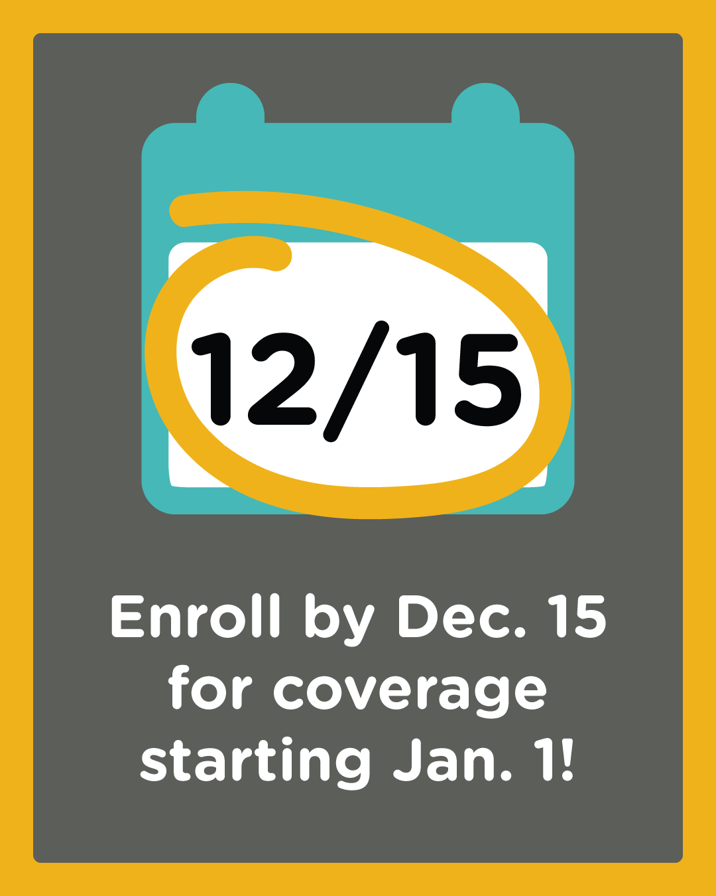
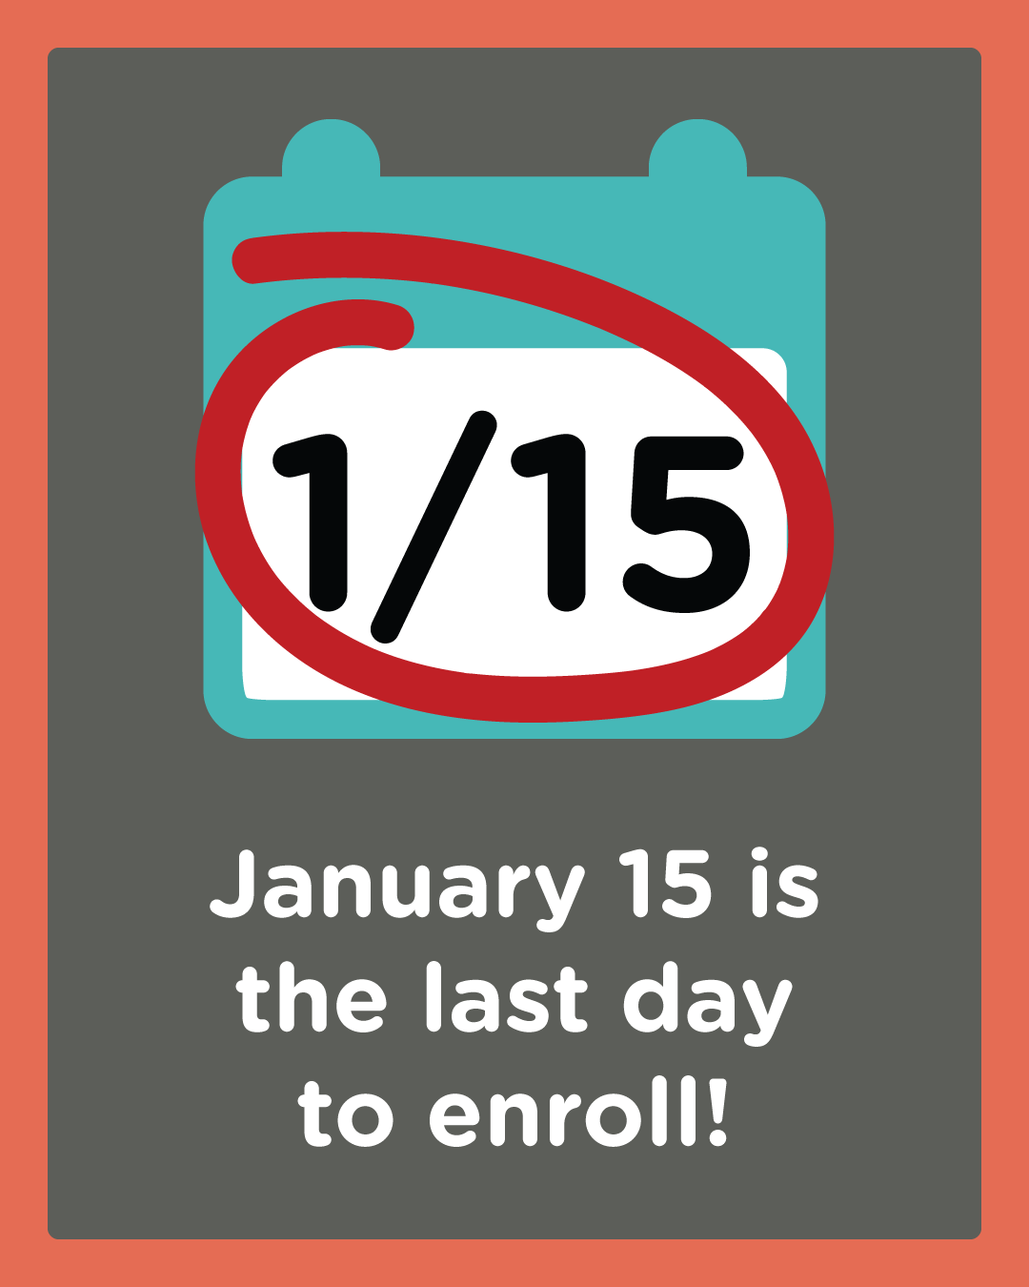
Open Enrollment Key Dates
Notes:
Open enrollment is November 1, 2025 – January 15, 2026.
Sign up by December 15 for coverage starting January 1.
If you miss the December deadline, your coverage will start February 1 instead.

Slide 4
Talking Points About MNsure
MNsure Overview
MNsure is Minnesota’s official health insurance marketplace, where individuals and families who buy coverage on their own can shop, compare plans, and enroll in health insurance.
MNsure is the only place Minnesotans can access federal financial help to lower health care costs.
MNsure makes it easy to:
  Get a quick cost estimate to see if you may qualify for free or lower-cost health insurance, or tax credits that lower your monthly costs.
  Compare plans side-by-side from multiple companies.
  Find free local help from a statewide network of health insurance experts.
About the Plans
MNsure partners with five insurance companies offering private health plans and another five who offer dental plans — so you have plenty of options at your fingertips.
Minnesotans can feel confident knowing they have lots of good health insurance choices.
All Minnesotans have health plan choices from at least two insurance companies — and most Minnesotans have choices from three or more.
Notes:
FAQs starting on page 14 to address consumer questions about MNsure’s open enrollment.

Slide 5
Talking Points About MNsure (continued)
Financial Help and Federal Changes
Plans and prices change every year, but this year Minnesotans may see big changes.
It’s more important than ever to shop and compare all your options. Don’t assume you can’t afford coverage if you’re feeling some sticker shock right now.
If you’ve had the same plan for years, don’t just hit “repeat” — there may be a better fit for your needs and budget.
Even if some federal savings end, many Minnesotans will still qualify for financial help next year.
Take advantage of free expert help — talk to a MNsure-certified navigator or broker who can help you apply or understand your options. You and your family are worth staying covered.
Buyer Beware: Avoid “Junk Plans” and Scammers
All private plans sold through MNsure are guaranteed to cover the important health care services that people need, like doctor visits, prescriptions drugs, and emergency care.
MNsure partners with reputable, licensed companies, so you get coverage you can trust.
Plans sold elsewhere may not offer the same benefits and could leave you stuck with high medical bills when you get care.
The best advice for consumers is to make sure they’re going to MNsure.org to shop and compare plans.
We also recommend talking to a MNsure-certified broker who can help you find the best plan that fits your needs and budget.
Notes:
FAQs starting on page 15 to address consumer questions about MNsure’s open enrollment.

Slide 6
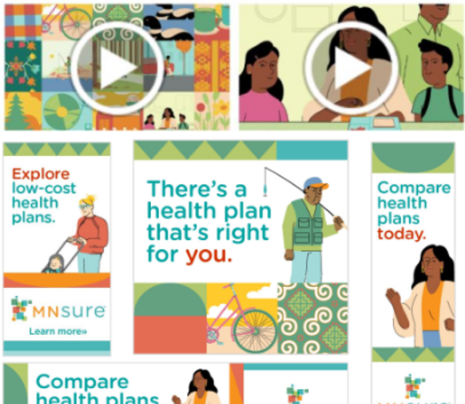
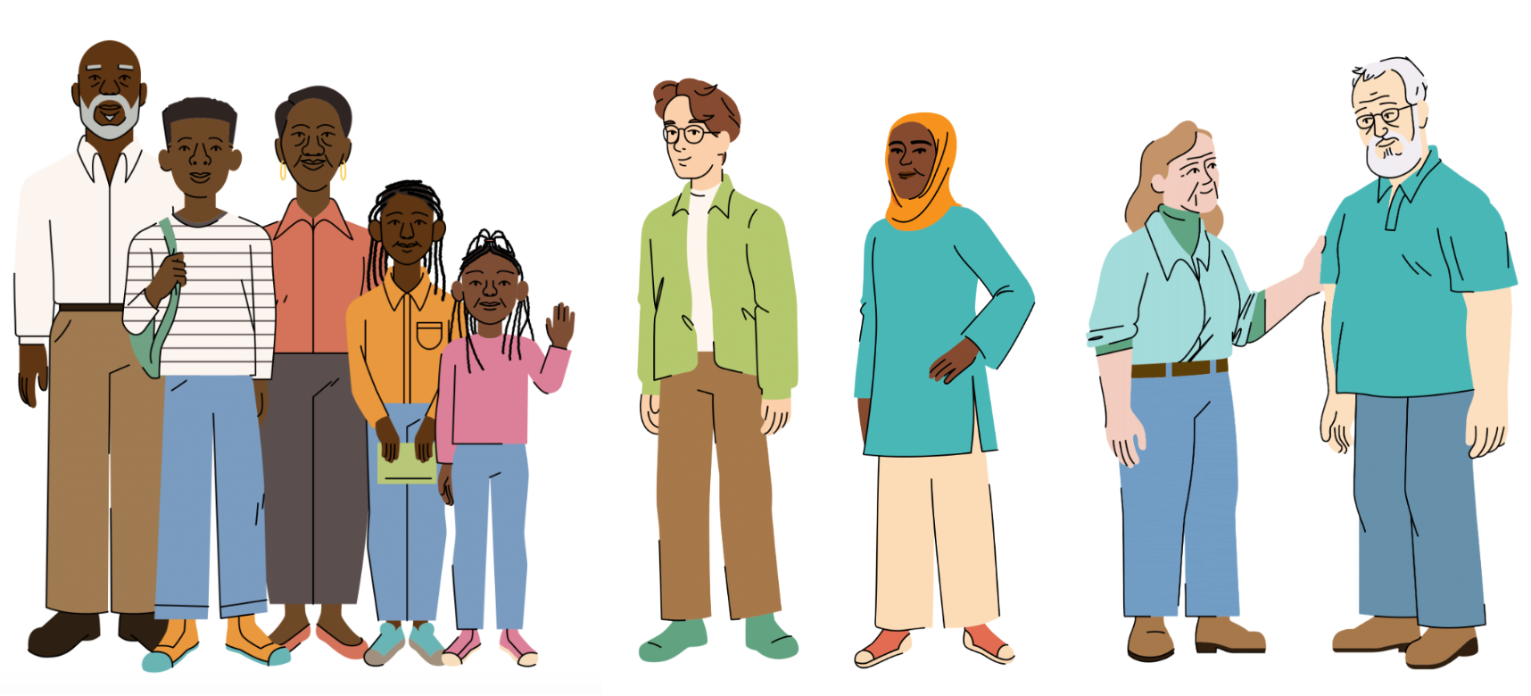
Marketing Campaign Overview
MNsure’s paid marketing campaign launches October 27.
We’re continuing the momentum from last year with familiar visuals and the “Now what?” theme, reinforcing MNsure as the next step for Minnesotans seeking coverage.
The campaign emphasizes MNsure’s role as a trusted, accessible guide for individuals and families navigating health insurance options.
This year’s campaign will have a similar look and feel: vibrant, colorful, upbeat musical tones, and culturally-relevant mosaic tiles.
We’re expanding our animated “cast of characters” to better represent more Minnesota families, including those in rural communities.

Slide 7




Social Media
Thank you for helping Minnesotans are covered for next year by making a plan to enroll.
In this social media toolkit, you will find graphics and social posts to share on your social media accounts. Sharing interesting, relevant or timely messages on social media can help you grow your following, raise awareness of the services you provide, and reach more community members. Ultimately, this helps more Minnesotans access health insurance through MNsure.
When sharing content, please include the hashtag #GetCoveredMN and tag us. We also encourage you to follow MNsure’s accounts and like and share our posts!

Slide 8
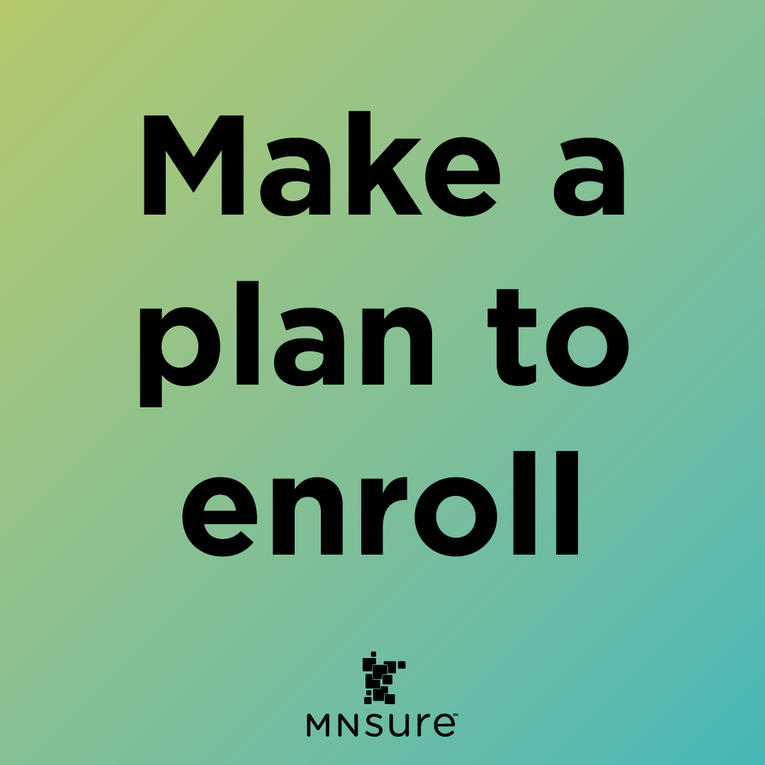
Social Media: Graphic 1
Post copy:
  More Minnesotans are insured than ever before —let’s keep that momentum going in 2026! Make a plan to enroll starting November 1. Visit MNsure.org to get started. #PlanToEnroll
    Image alt text: Blue & green gradient with text: “Make a plan to enroll”
Download this image

Slide 9
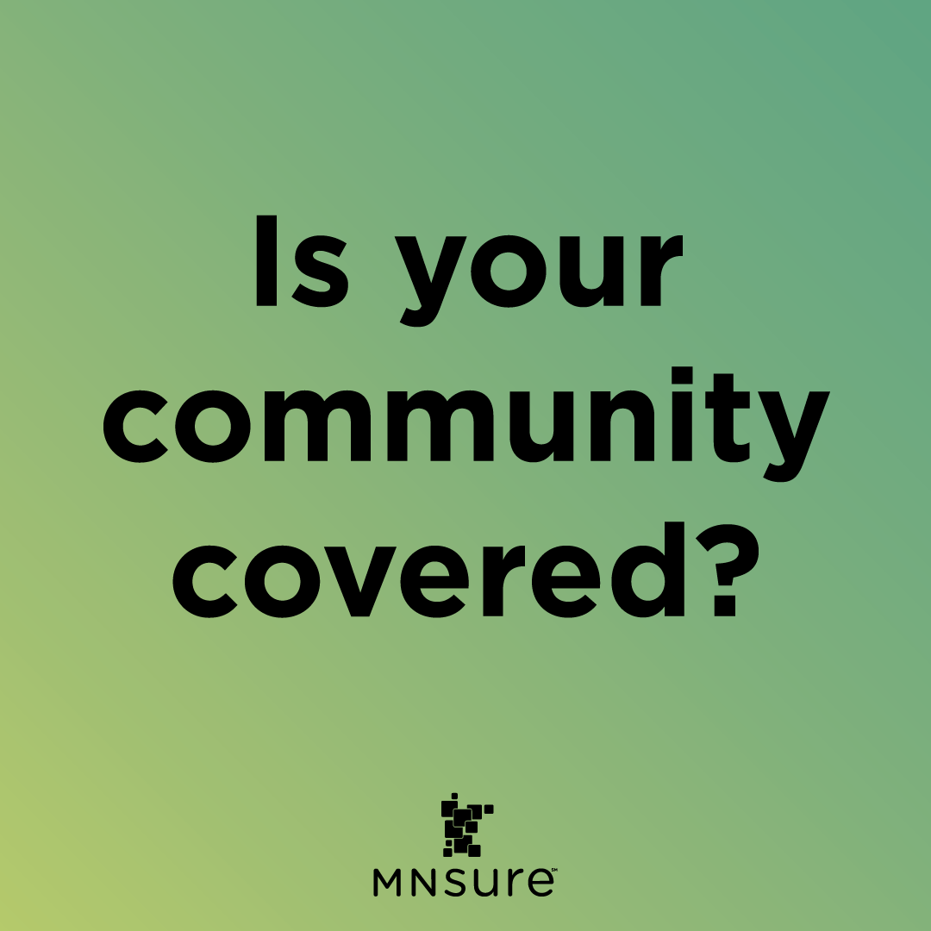
Social Media: Graphic 2
Post copy:
  This open enrollment, check in with your friends, loved ones and neighbors — do they have coverage for 2026? Let’s make sure every Minnesotan is protected.
    Image alt text: Light & dark green gradient with text: “Is your community covered?”
Download this image

Slide 10
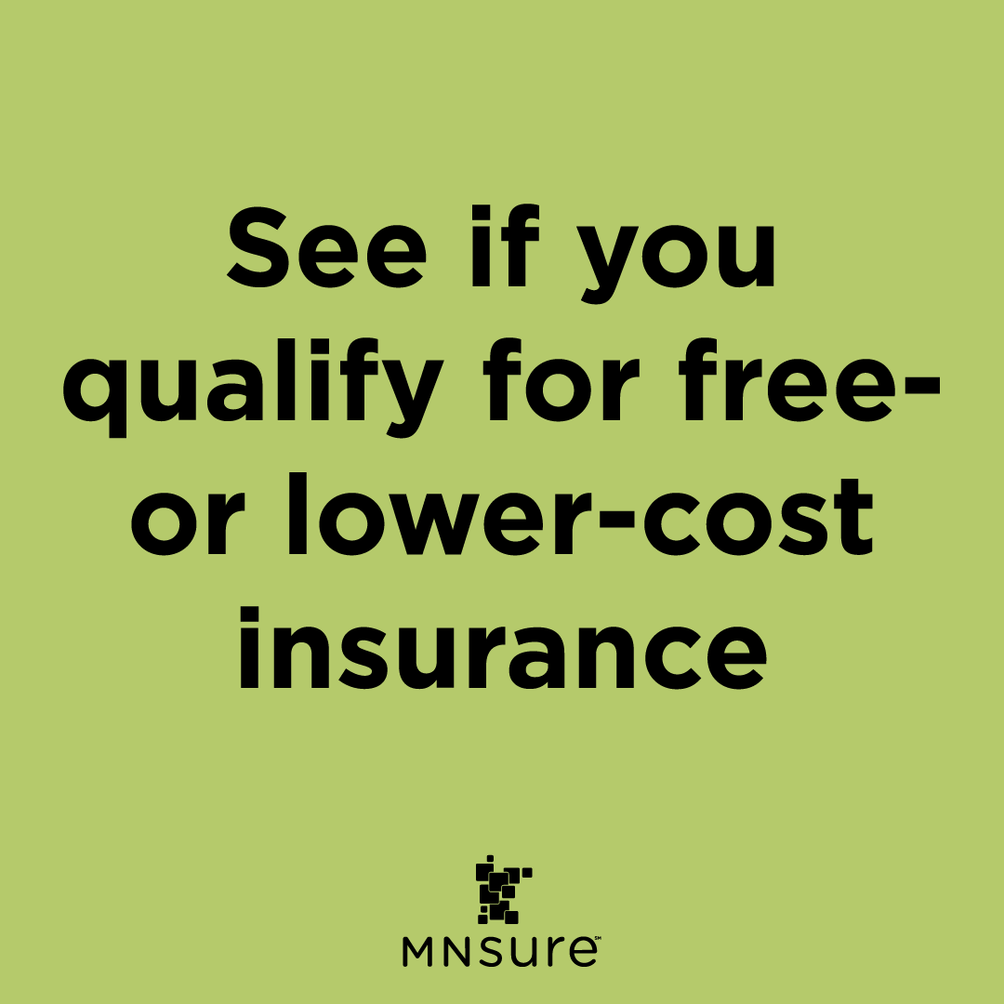
Social Media: Graphic 3
Post copy:
  Apply through MNsure and find out if you're eligible for free or lower-cost health insurance through Medical Assistance (Minnesota's Medicaid) or MinnesotaCare, or tax credits to lower the cost of a private plan. Get a quick estimate: mnsure.org/shop-compare
    Image alt text: Green square with text: “See if you qualify for free- or lower-cost insurance”
Download this image

Slide 11
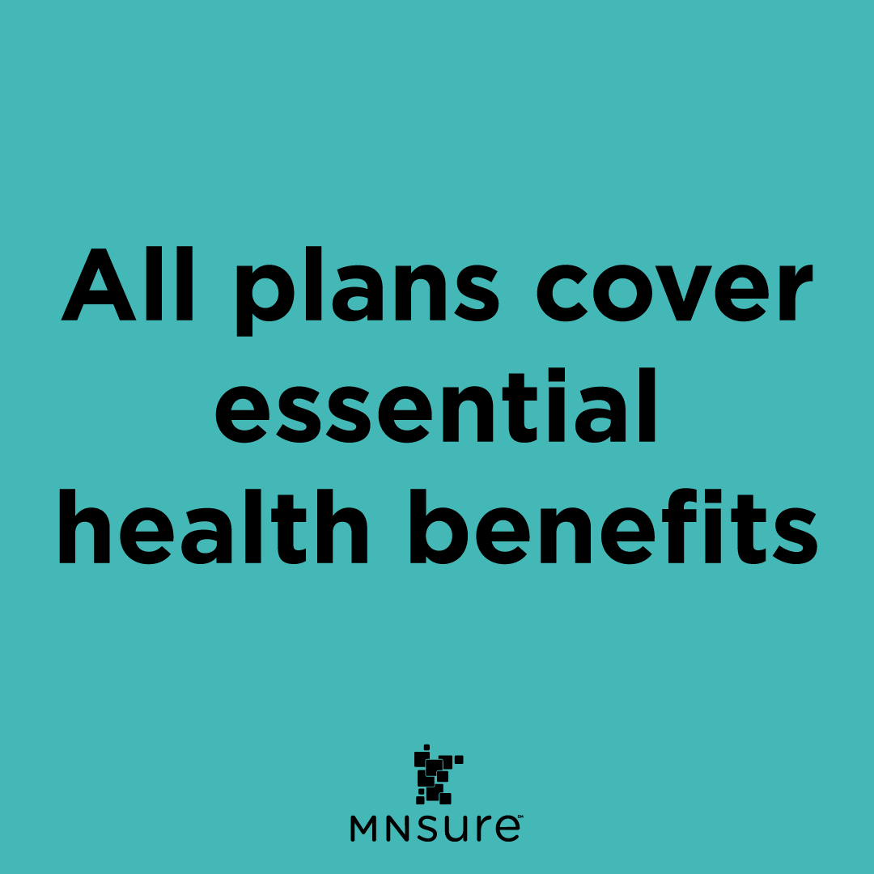
Social Media: Graphic 4
Post copy:
  Every plan sold through MNsure covers care like doctor visits, prescriptions, and mental health care. Don’t settle for anything less! Start your plan shopping here: MNsure.org/shop-compare
    Image alt text: Blue square with text: “All plans cover essential health benefits”
Download this image

Slide 12

Social Media: Graphic 5
Post copy:
  Need health insurance but not sure where to start? MNsure-certified experts offer free help to compare plans and enroll with confidence. Get support: MNsure.org/free-help
    Image alt text: Light gray squares with text: “Get free help from a trusted expert”
Download this image

Slide 13
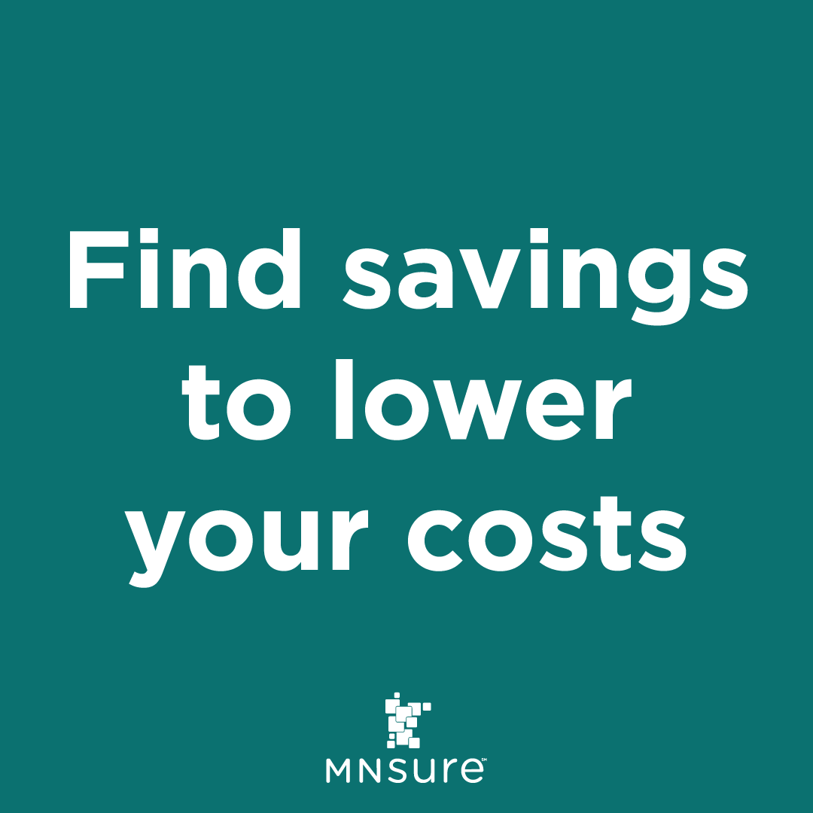
Social Media: Graphic 6
Post copy:
  MNsure is the only place Minnesotans can find savings to help lower your monthly costs. Open enrollment runs Nov. 1 – Jan. 15. Make a plan to explore your options.
    Image alt text: Dark teal box with text: “Find savings to lower your costs”
Download this image

Slide 14

Social Media: Graphic 7
Post copy:
  Health insurance protects the people you love. Make sure your family is covered for 2026. Let’s keep Minnesota healthy, together.
    Image alt text: A family playing in the snow. Text box: "Protect your family's health“
Download this image

Slide 15
FAQ (page 1)
What is open enrollment?
  Open enrollment is the time each year when Minnesotans can sign up for private health insurance through MNsure. It’s also when you can change or renew your current plan.
When is open enrollment for 2026 coverage?
  Open enrollment runs from November 1, 2025, to January 15, 2026.
    Enroll by December 15 for coverage starting January 1, 2026
    Enroll between December 16 and January 15 for coverage starting February 1, 2026

Slide 16
FAQ (page 2)
Can I shop for plans before November 1?
  Yes! You can visit https://www.mnsure.org/shop-compare to preview 2026 plans and get a free, anonymous estimate of your costs and savings.
What’s new for 2026?
  All Minnesotans have plan choices from at least two insurance companies —most have choices from three or more.
  All bronze plans now work with health savings accounts (HSAs).
  MNsure now offers dental plans from five companies, including new partners Companion and Humana.

Slide 17
FAQ (page 3)
Will health insurance cost more this year?
  Some Minnesotans may see higher premiums in 2026 because enhanced tax credits are ending. But many people will still qualify for financial help. Eligible families can save an average of $600 per month — that’s over $7,000 a year — on private health plans through MNsure.
How do I find out if I qualify for savings?
  Use MNsure’s online plan comparison tool. You’ll just need:
    Where you live
    Who’s in your household
    Your total household income

Slide 18
FAQ (page 4)
Can I get help enrolling?
  Yes! MNsure offers free help from trained experts:
    Visit one of MNsure’s 22 broker enrollment centers for walk-in assistance
    Connect with a certified assister for help in person, by phone, or online
    Use the directory at https://www.mnsure.org/free-help to find someone near you.
What if I miss open enrollment?
  You may still qualify for a special enrollment period if you’ve had a major life change —like having a baby, getting married or turning 26. These events may allow you to sign up outside the regular enrollment window.

